Slide 1

NLP: Topic clustering with LDA
Kaggle data: Women’s Clothing E-Commerce dataset
Salla Rönkä

Slide 2
a Women’s Clothing E-Commerce dataset
This dataset includes 23486 rows and 10 feature variables. Each row corresponds to a customer review, and includes the variables:
Clothing ID: Integer Categorical variable that refers to the specific piece being reviewed.
Age: Positive Integer variable of the reviewer’s age.
Title: String variable for the title of the review.
Review Text: String variable for the review body.
Rating: Positive Ordinal Integer variable for the product score granted by the customer from 1 Worst, to 5 Best.
Recommended IND: Binary variable stating where the customer recommends the product where 1 is recommended, 0 is not recommended.
Positive Feedback Count: Positive Integer documenting the number of other customers who found this review positive.
Division Name: Categorical name of the product high level division.
Department Name: Categorical name of the product department name.
Class Name: Categorical name of the product class name.
Dataset can be downloaded from here: https://www.kaggle.com/nicapotato/womens-ecommerce-clothing-reviews
Project Github: https://github.com/annilea/nlp-on-e-commerce-reviews

Slide 3
Data exploration

Slide 4


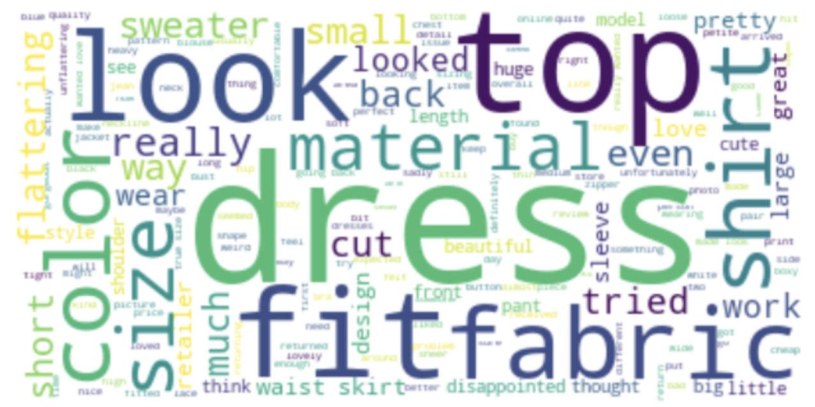
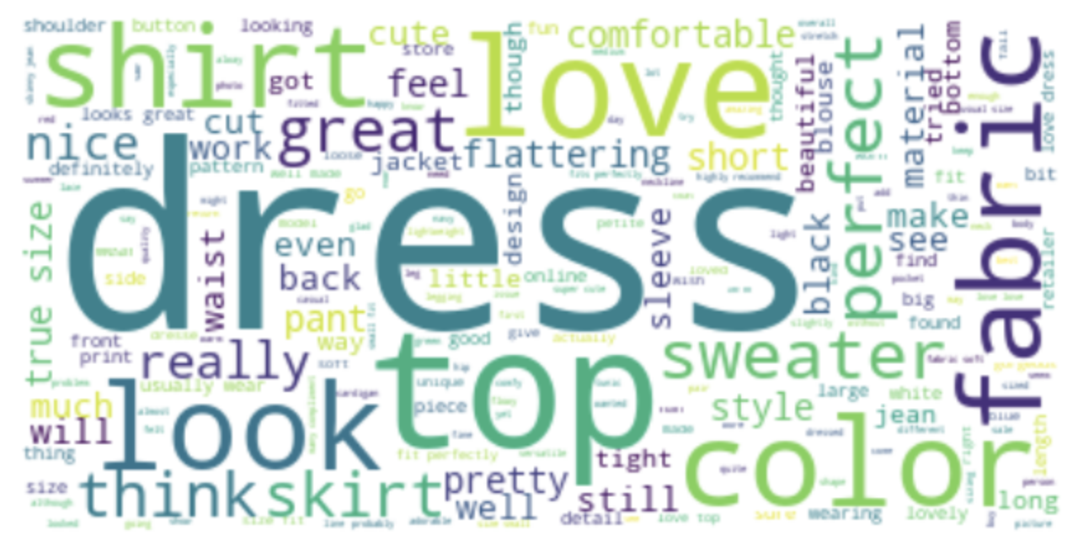
Wordcloud of reviews where customer did not want to recommend the product
Wordcloud of reviews where customer gave a recommendation
Similar words have been used in both recommending and non-recommending reviews.

Slide 5
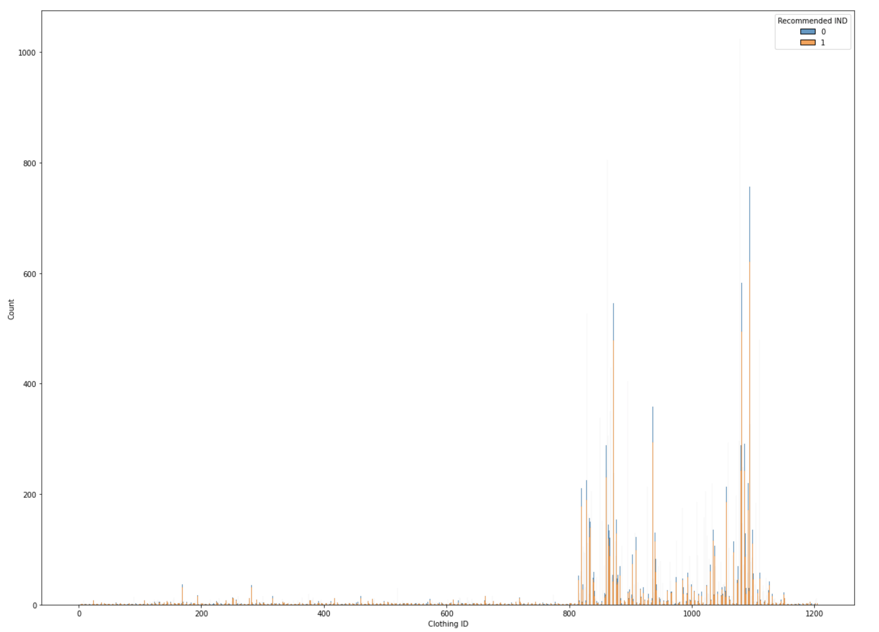
The recommen-dations are given mostly on same products
Are we seeing the popular products here?
Some products get way more reviews in total. It would be interesting to understand why! Are they older/popular/…

Slide 6
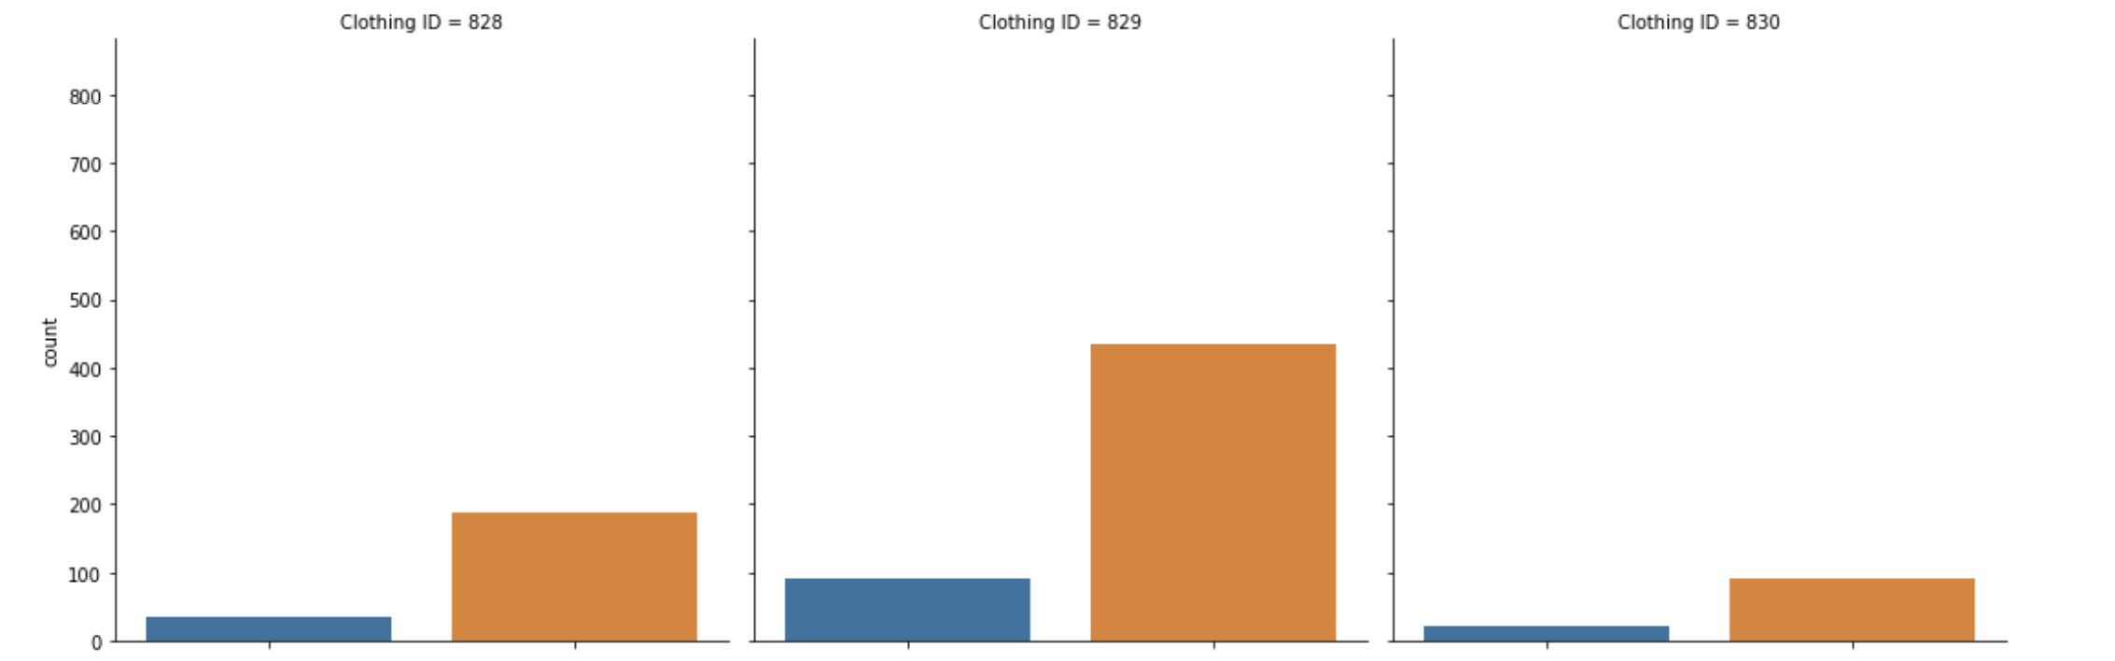
In general products have more recommendations than non-recommendations
Some people have found the same product good (orange) and others don't want to recommend (blue).
It is important to understand why and what separates these shoppers! This could guide new shoppers in finding a suitable product if they can understand what has been a good choice for similar people. It would also help in sustainability as ordering and returning products creates a load on our environment. Unfortunately, we don't have much shopper specific information in this dataset but we can use the review texts to try and understand the WHY better!
-> topic analysis

Slide 7
Supervised learning and Auto-ML

Slide 8
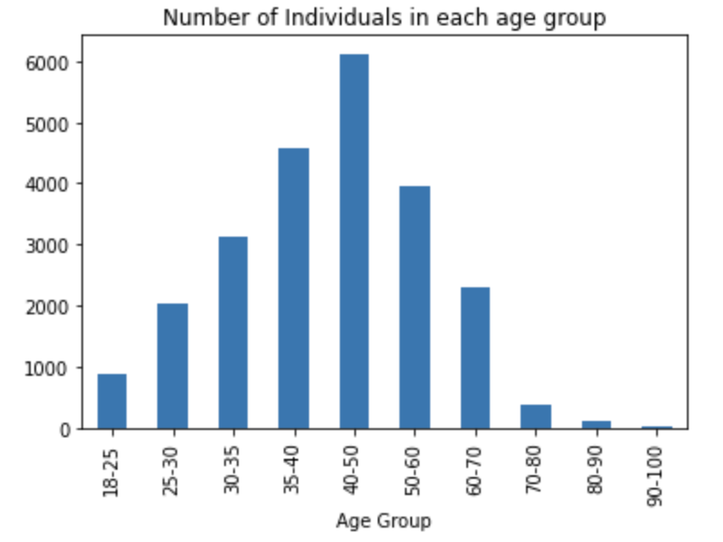
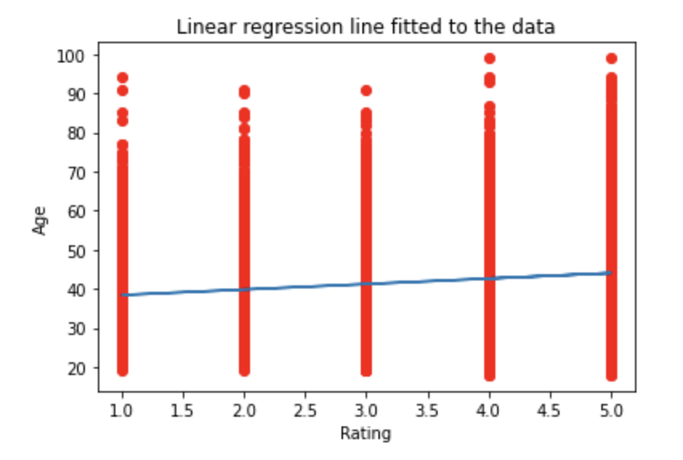
Do age groups give different ratings?
Older people tend to give slightly better ratings. Is this the target age group?

Slide 9
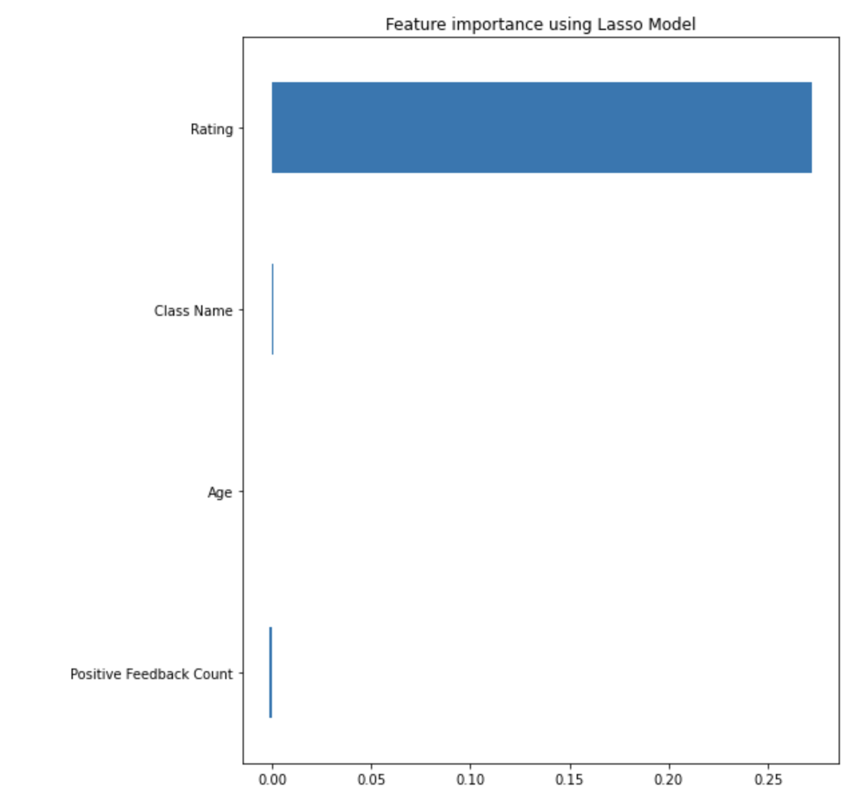
Supervised methods to predict whether customer would recommend a product (Recommended IND as target)
It seems that rating is a good indicator to whether someone would recommend a product ;)
This portion of the analysis makes sense only from the learning perspective but I continued anyhow to test AutoML with tpot: https://medium.com/rapids-ai/faster-automl-with-tpot-and-rapids-758455cd89e5

Slide 10
Tpot results
HBox(children=(FloatProgress(value=0.0, description='Optimization Progress', max=240.0, style=ProgressStyle(de…
Generation 1 - Current best internal CV score: 0.9364355231143552 Generation 2 - Current best internal CV score: 0.9364355231143552 Generation 3 - Current best internal CV score: 0.9365571776155719 Generation 4 - Current best internal CV score: 0.9365571776155719 Generation 5 - Current best internal CV score: 0.9365571776155719
Best pipeline: ExtraTreesClassifier(ZeroCount(input_matrix), bootstrap=True, criterion=entropy, max_features=0.6500000000000001, min_samples_leaf=15, min_samples_split=17, n_estimators=100) 0.933863184785694
Results for the tpot best model:
Accuracy = 0.9355662787397104, Precision = 0.9821105890856523,
Recall = 0.9386873920552677,
F1-score = 0.9599081596608973 Confusion Matrix is:
[[1157 99]
[ 355 5435]]

Slide 11
Unsupervised learning with LDA

Slide 12
Latent Dirichlet Allocation (LDA)
https://www.jmlr.org/papers/volume3/blei03a/blei03a.pdf
The LDAModel provided by genism was used here
The process:
Preprocessed data (removed unwanted characters, lemmatized keeping only nouns and verbs, created bigrams, removed stop words)
Created the dictionary (id and word)
Created corpus (per document: word id and how many times the word is present)
Find good amount of topics and other hyperparameters
Train topic model
Analyze results

Slide 13
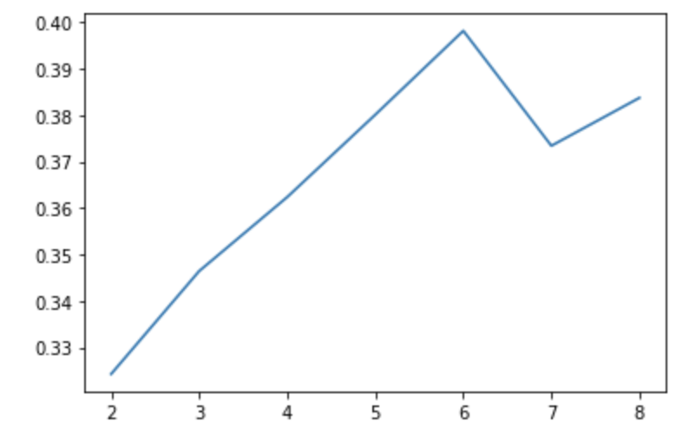
Selecting the best amount of topics
The amount of clusters that would maximize the coherence score with this dataset while keeping alpha and beta constant is 6.

Slide 14
Selecting the best hyperparameters for k=6 hyperparameter sweep
K alpha beta coherence score
6 0.01 0.01 0.35414264773335064
6 0.01 0.31 0.30228672852309907
6 0.01 0.61 0.3287052607248521
6 0.01 0.9099999999999999 0.35391164929553653
6 0.01 symmetric 0.3028531472317016
6 0.31 0.01 0.36233582587953855
6 0.31 0.31 0.375537157552117
6 0.31 0.61 0.38111431658258715
6 0.31 0.9099999999999999 0.3906245420171781
6 0.31 symmetric 0.3738809379339389
6 0.61 0.01 0.3969656848796166
6 0.61 0.31 0.4062319461986598
6 0.61 0.61 0.4170581162519786
6 0.61 0.9099999999999999 0.42525113904834994
6 0.61 symmetric 0.40920840715178897
6 0.9099999999999999 0.01 0.39128699988720356
6 0.9099999999999999 0.31 0.40427791379121203
6 0.9099999999999999 0.61 0.4177387503520917
6 0.9099999999999999 0.9099999999999999 0.4281663084830935
6 0.9099999999999999 symmetric 0.4021105801232954
6 symmetric 0.01 0.35964723120659065
6 symmetric 0.31 0.33701972292516275
6 symmetric 0.61 0.3605249919301355
6 symmetric 0.9099999999999999 0.32187126051864334
6 symmetric symmetric 0.33331164107517447
6 asymmetric 0.01 0.3434175317954762
6 asymmetric 0.31 0.3292974406287992
6 asymmetric 0.61 0.33065168411161366
6 asymmetric 0.9099999999999999 0.32498840324370704
6 asymmetric symmetric 0.32408715044753267
Select max coherence
Dirichlet hyperparameter alpha: Document-Topic Density
Dirichlet hyperparameter beta: Word-Topic Density

Slide 15
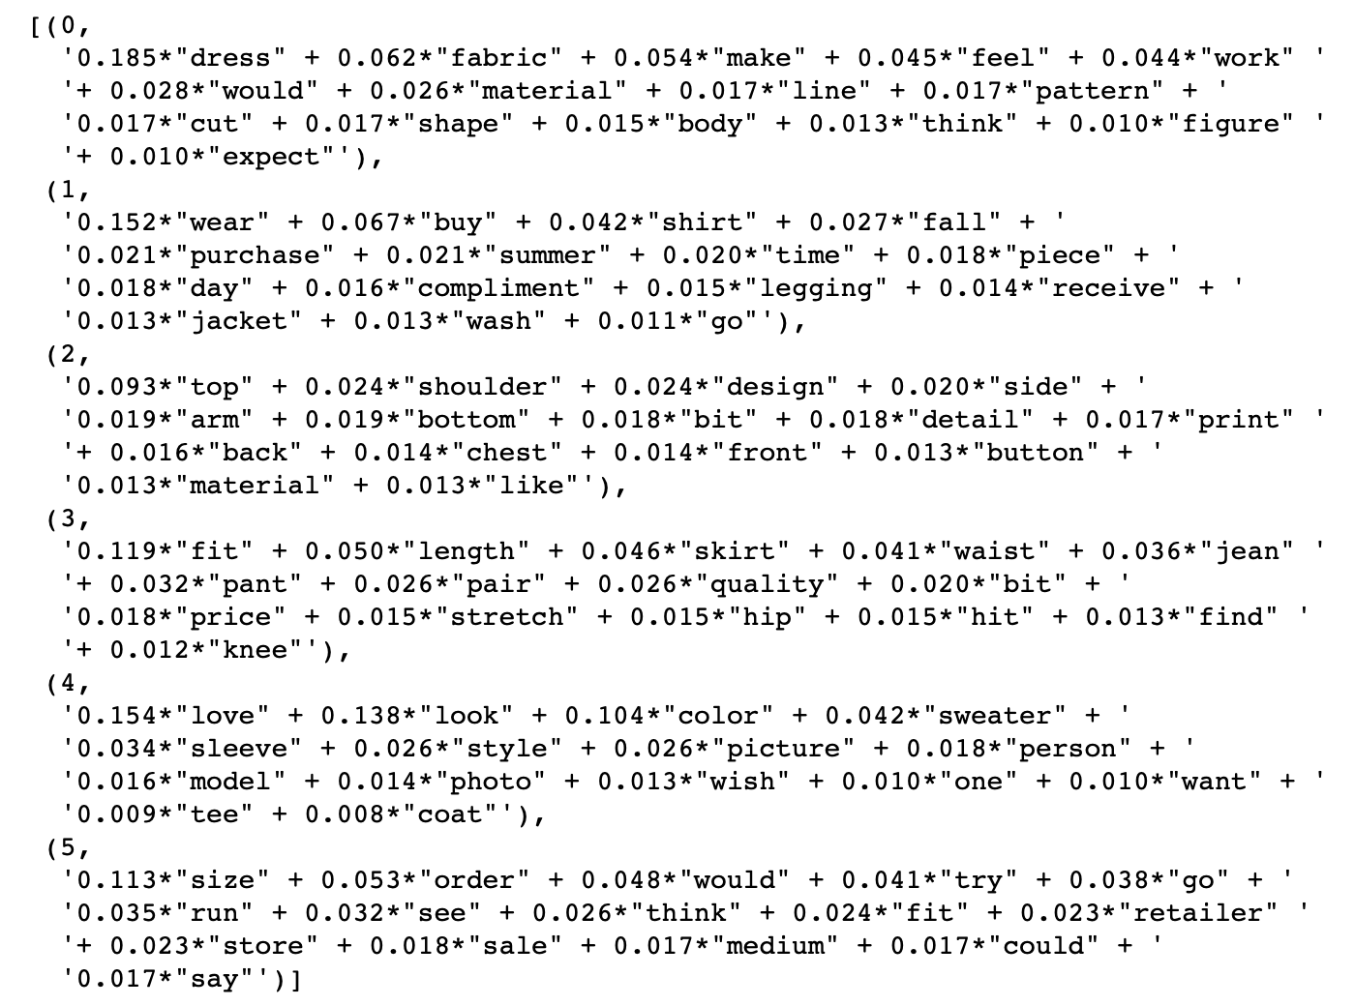
The model created with best hyperparameters
Visualizing the most common words in each topic
Naming the topics:
topic_names ={0:'dresses and fabric', 1:'wearing and season', 2:'tops and tees', 3:'bottoms', 4:'love the style', 5:'size’}
Could try adding types of clothes to stopwords and see how the results would look like then.

Slide 16
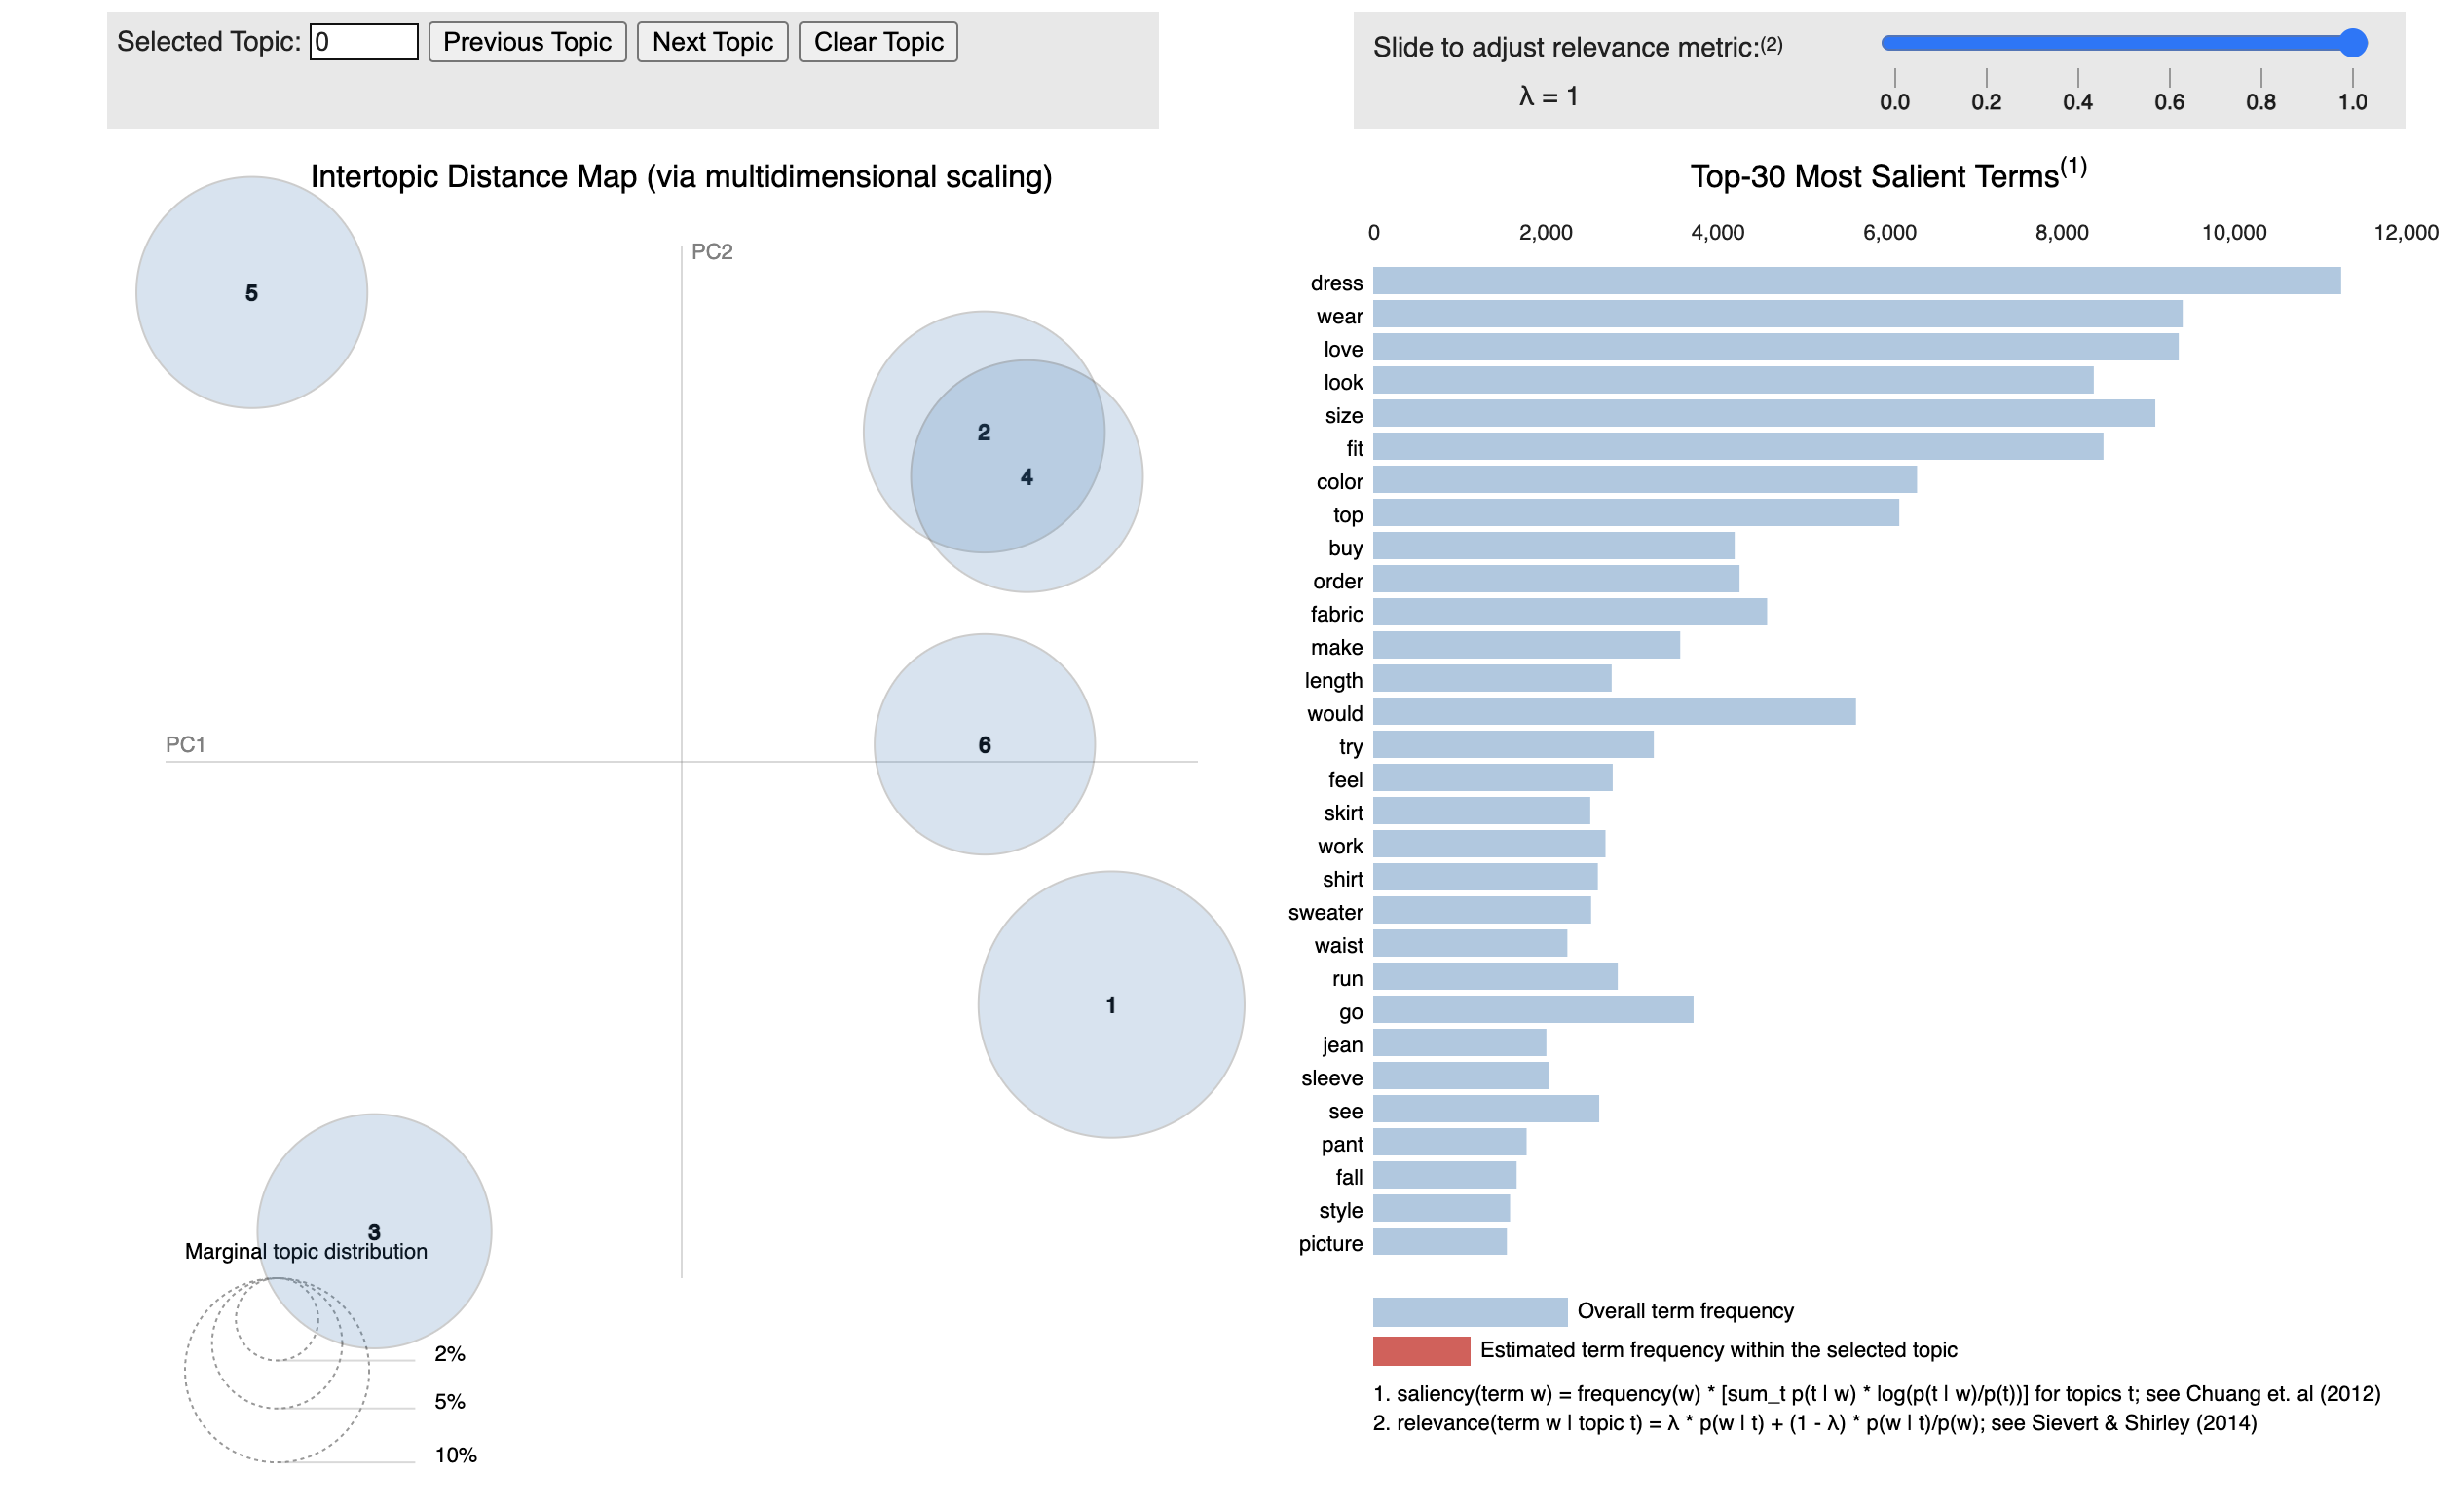
LDAViz used for examining the results of topic clustering
Each bubble on the left-hand side plot represents a topic. The larger the bubble, the more prevalent is that topic.
A good topic model will have fairly big, non-overlapping bubbles scattered throughout the chart instead of being clustered in one quadrant.
A model with too many topics, will typically have many overlaps, small sized bubbles clustered in one region of the chart.
Read more here: https://cran.r-project.org/web/packages/LDAvis/vignettes/details.pdf
red bars: estimated number of times a given term was generated by a given topic blue bars: overall frequency of each term in the corpus
Note that the numbers in the bubbles do not mean the cluster numbers!

Slide 17
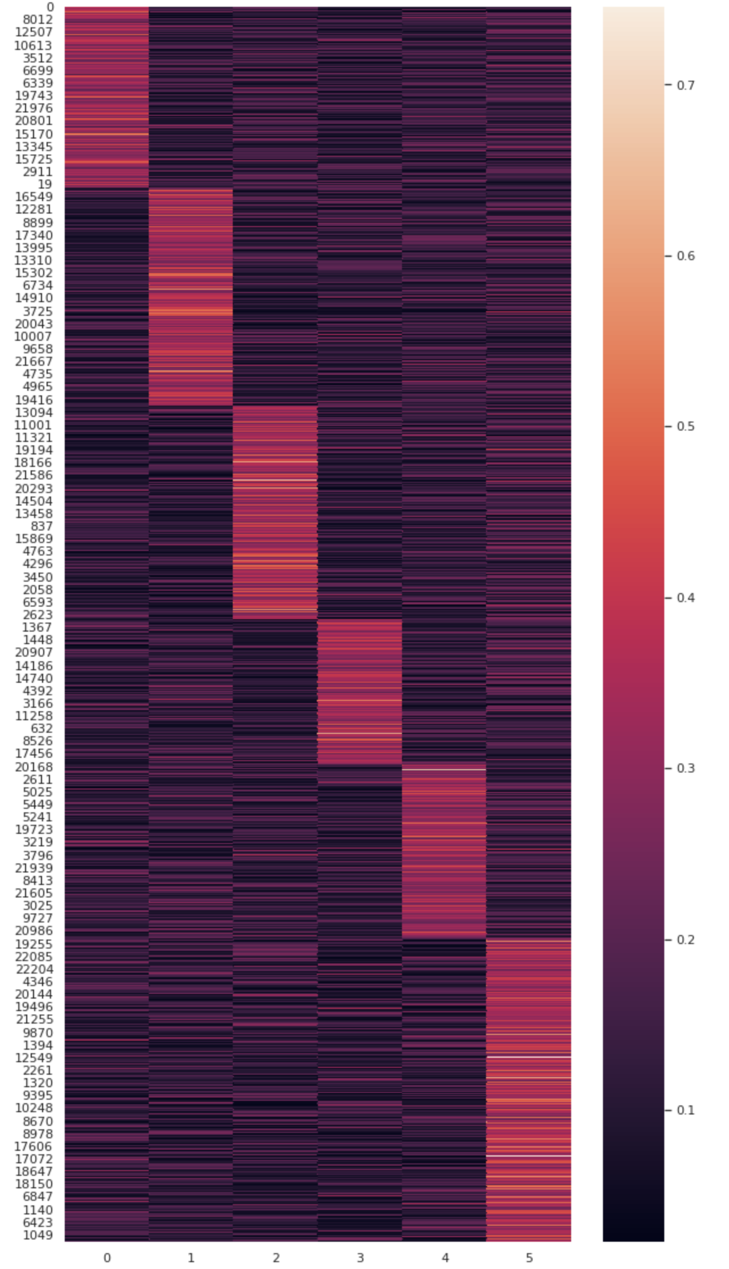
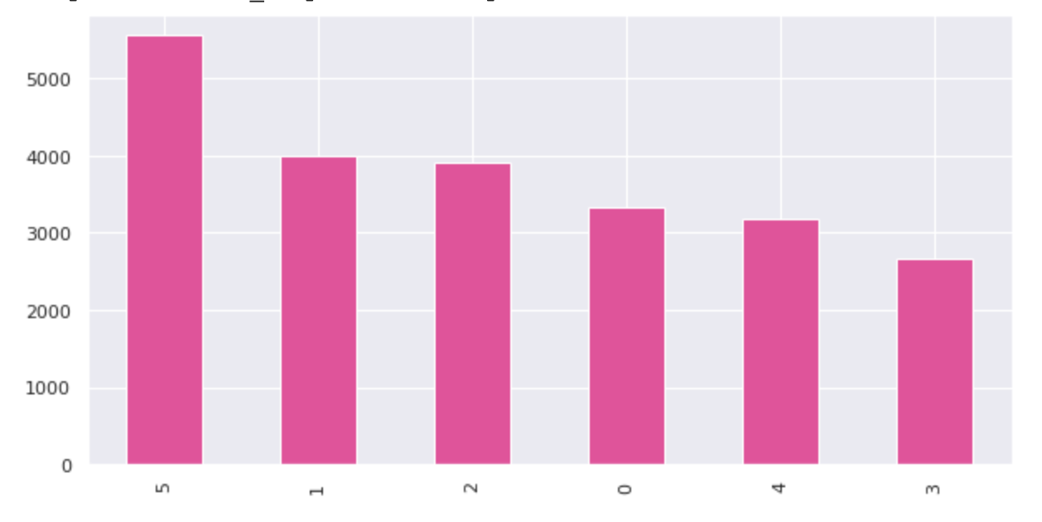
The most probable topic of reviews
Being a Bayesian model LDA gives the probability of belonging to each class for a document. We can see that many documents do not clearly belong to only one topic
Size (5) is most common topic

Slide 18
Next steps
We have now created a topic model and added the found topics to the original dataframe. The analysis could be taken to multiple directions from here.
Plot rating per topic category
The category names could be adjusted.
We could do the same analysis but for a dataset where we divide the reviews by sentences to get a sentence specific topic. These could be used to get also sentiment per sentence. Then we can start monitoring how sentiment and amount of reviews in each topic develop over time on a dashboard.
We could find Products where e.g. size seems to be causing problems and decide the best course of action
etc.

